Slide 1
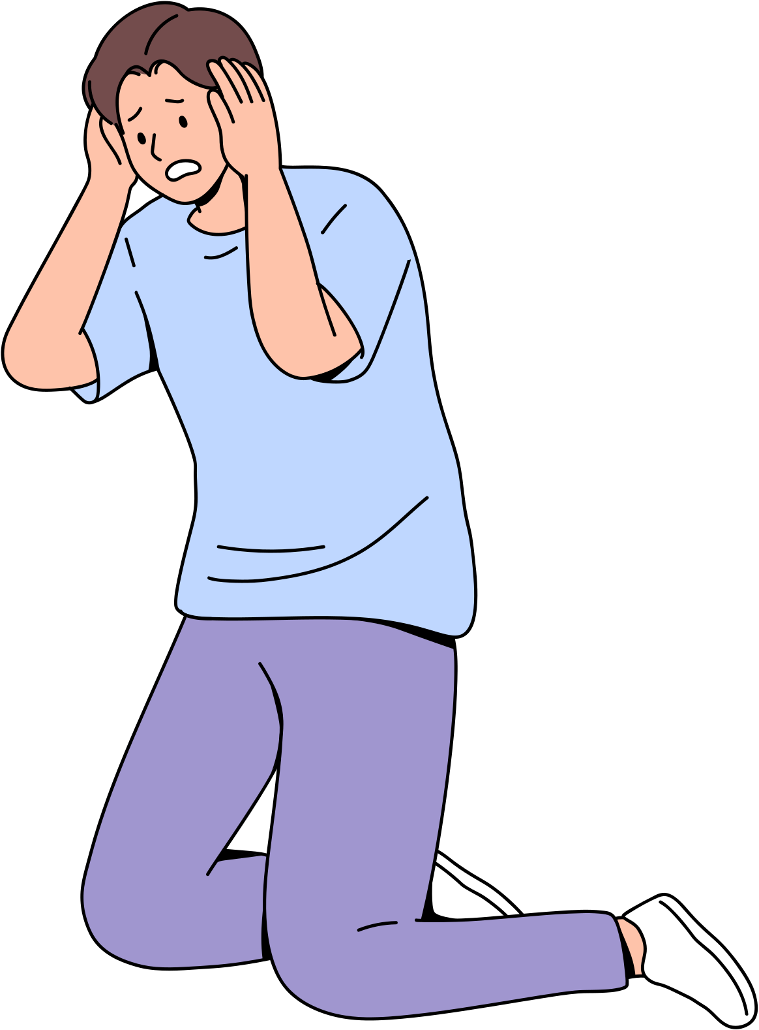
YOUR WELLBEING IS A PRIORITY
MENTAL HEALTH
AWARENESS

Slide 2
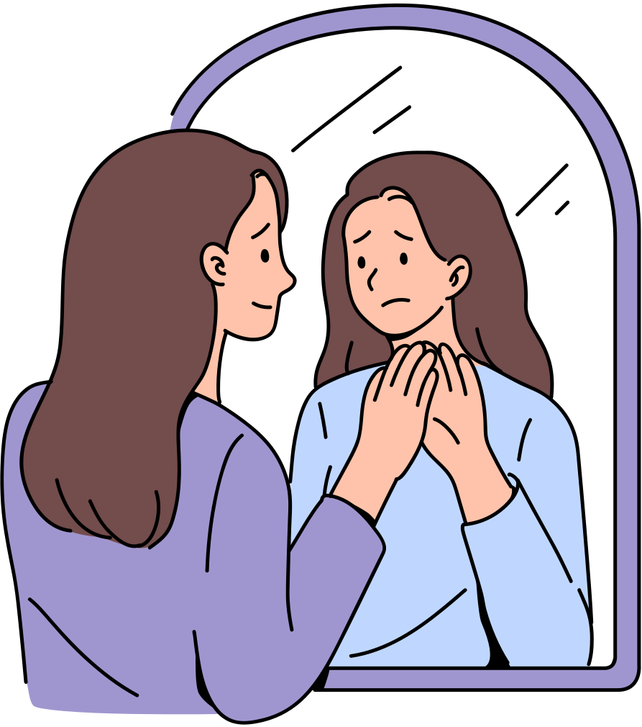
AGENDA
Mental Health Matters
What is Mental Health
Common Challenges
Signs to Look Out for
Ways to Care

Slide 3
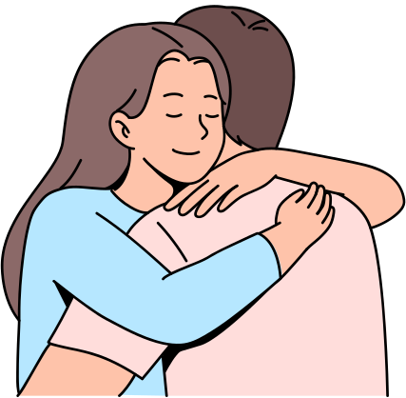
MENTAL HEALTH MATTERS
Mental health is just as important as physical health. It affects how we think, feel, and act — and it plays a big role in how we handle stress, relate to others, and make choices.

Slide 4
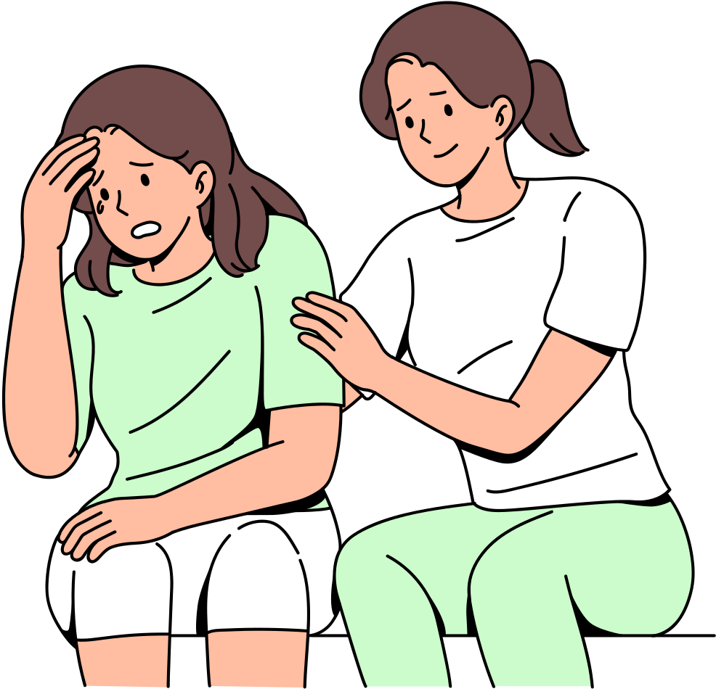
MENTAL HEALTH
WHAT IS
Mental health includes our emotional, psychological, and social well-being. It can change over time depending on life circumstances, stress levels, and support systems.

Slide 5
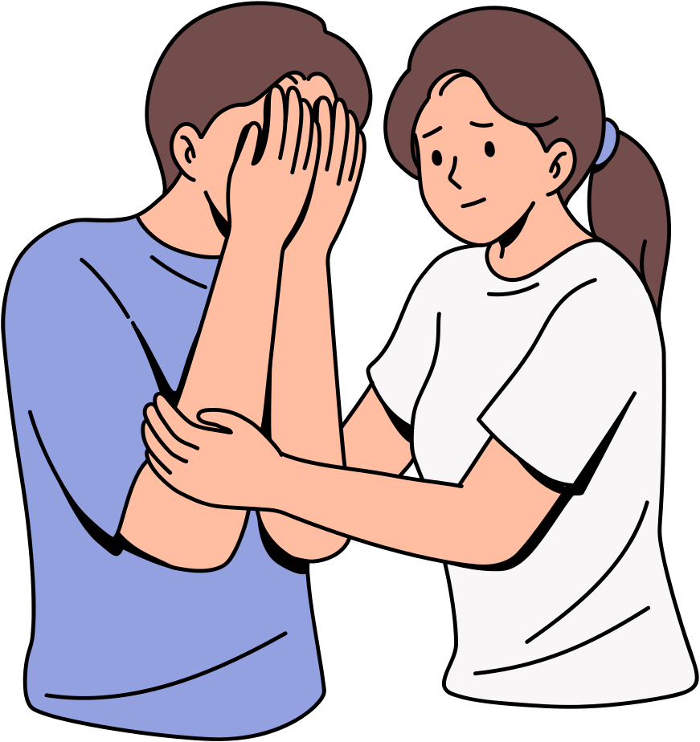
COMMON CHALLENGES
Everyone experiences ups and downs. Anxiety, depression, burnout, and stress are common mental health concerns.
They are nothing to be ashamed of.

Slide 6
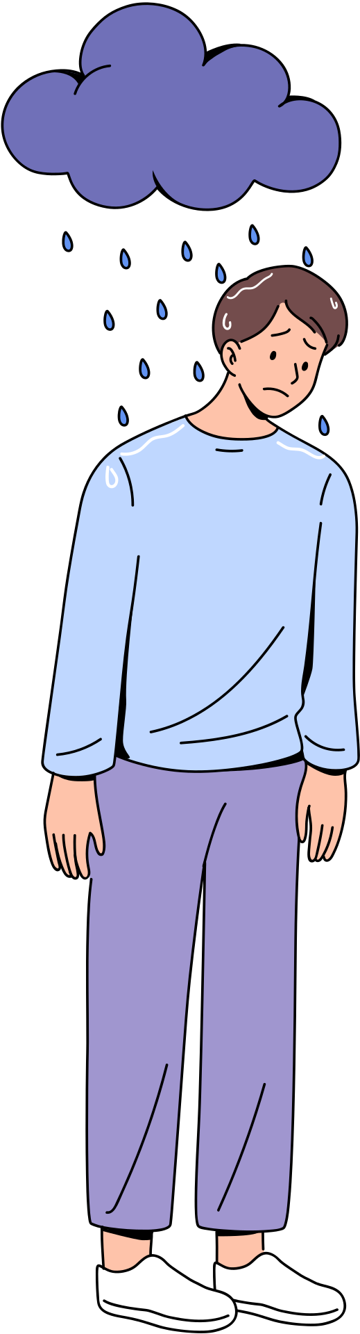
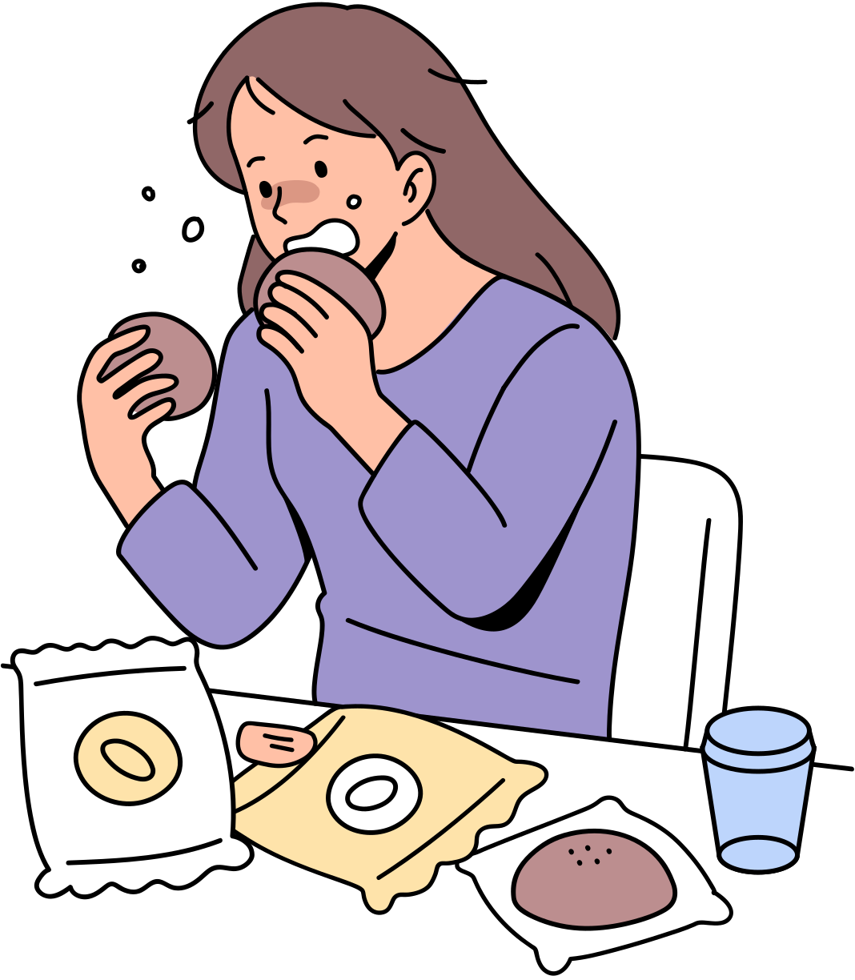
SIGNS TO LOOK OUT FOR
Feeling unusually sad or withdrawn
Changes in eating or sleeping habits
Constant worry or fear
Losing interest in things you used to enjoy

Slide 7
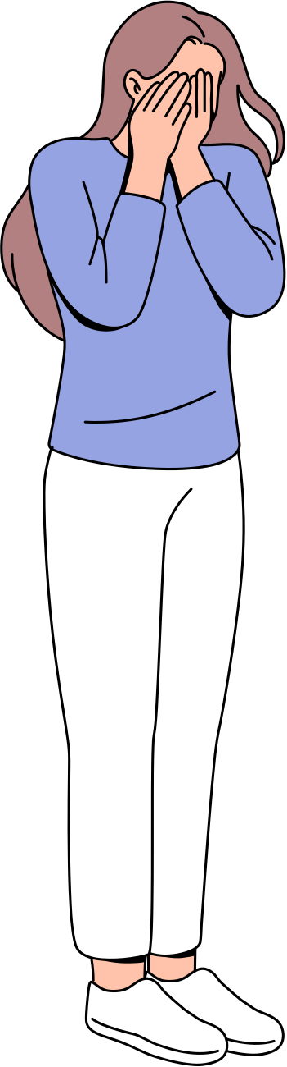
IT’S OKAY TO ASK FOR HELP!
Talking about mental health can be hard, but it’s a brave and important step.

Slide 8
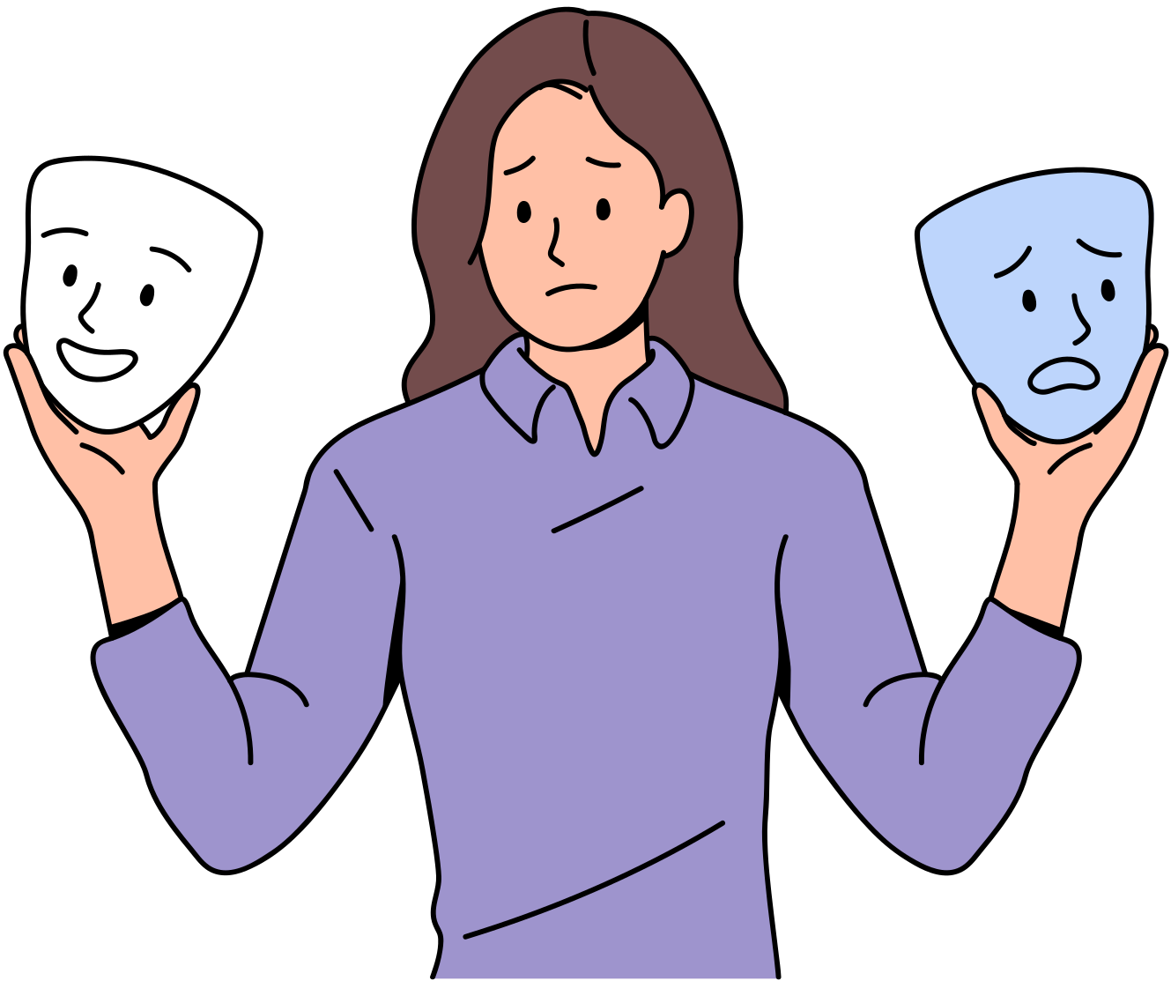
THINGS TO REMEMBER
You don’t have to be strong all the time.
Your mental health is worth protecting, always.

Slide 9

WAYS TO CARE
Talk it out
Take breaks
Sharing your feelings reduces stress.
Rest and recharge when needed.
Stay Active
Physical activity boosts your mood.

Slide 10
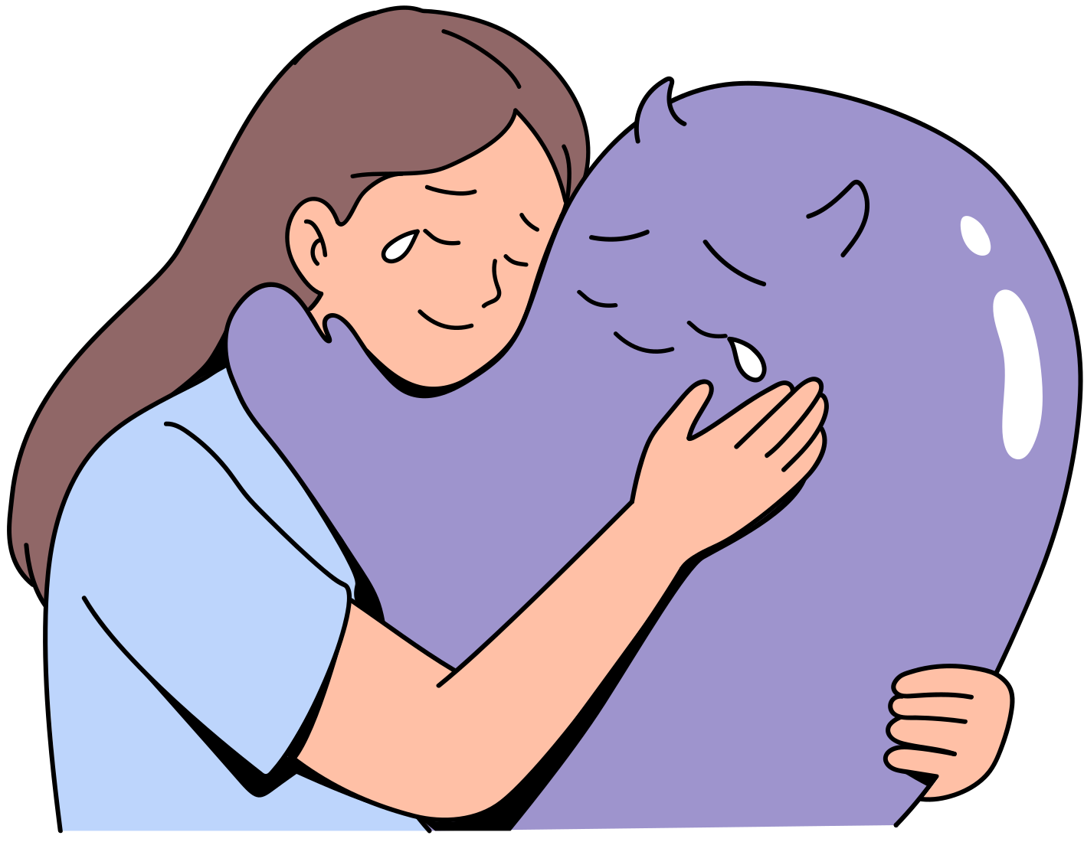



THANK YOU!
Let’s end the stigma.
Contact Us for Help!
23 blue valley
www.wedocare.com
Monday to Friday
080-354-278

